Slide 1

Final Internship Review
Calibration of Power Meter
Getting Quotations using Digikey’s API
Presented by Darshan

Slide 2
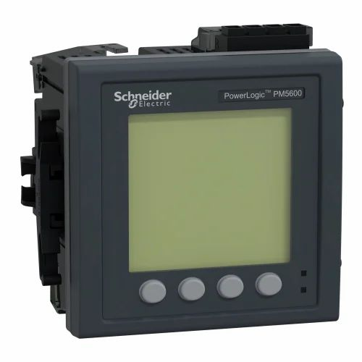
Project 1
Goal: Checking for the Calibration of a Power meter(Initially with 5600)
Scope of Work: - Auto Calibration’s step 1
(circuit in the same meter)
- Space Effective (Constraint turned into a Problem to solve)
- Saves on Time (Field Issue Resolving time)

Slide 3
Certain things to note down is : 1) The Designed circuit uses the power from the Meter’s circuit itself. 2) Currently covering a single test point ( V & I Supply) 3) Currently covering 1 value of CC AND CV each.

Slide 4
Project Constraints - Power (Maximum of 3W) - Space - Not having abundance of Voltage (and also Microcontroller’s 3.3V)

Slide 5
Approach to the Problem: 1) Need for a Known V and I (not flat)
Figured out we can take 3.3V of sine wave from the DAC output of the Power meter’s Microcontroller
- We can also use 6V of DC flat voltage from the power card of the Power meter.
Now we need to do two things,
1) Amplify current
2) Amplify Voltage
For current Amplification and Voltage Amplification we use two different op-amps which give rail –to – rail output.
-

Slide 6
Main Factors for Op-Amps selection: - Output Voltage condition should be met - Output Current condition should be met - Power Consumption

Slide 7
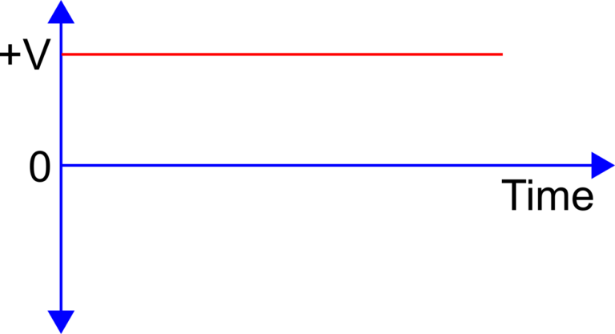
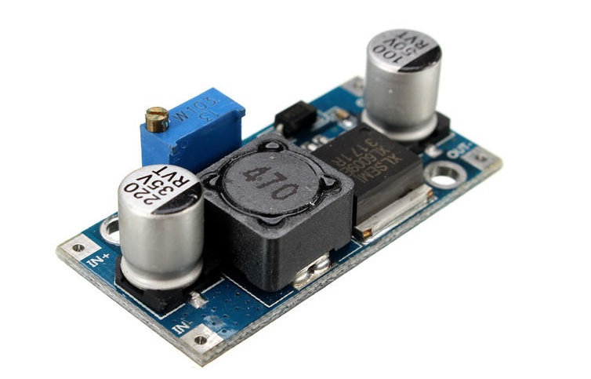
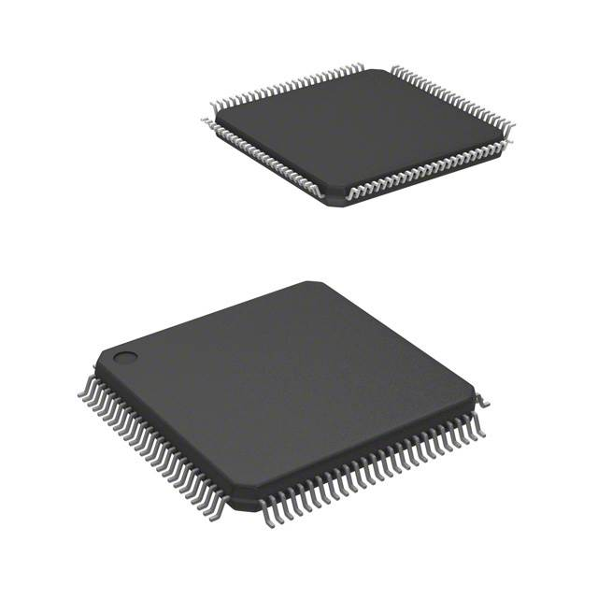
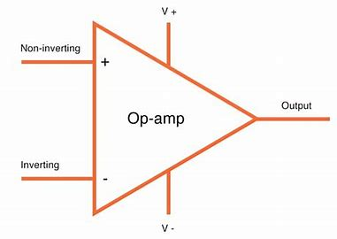
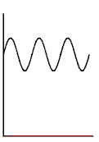


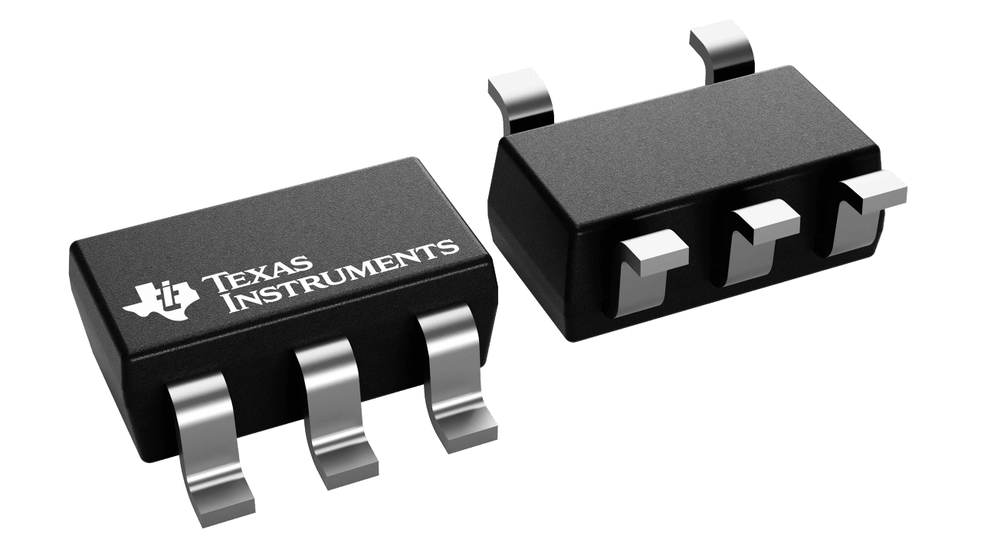
13/6 V DC flat Voltage is taken from the power supply board and given to Boost Converter
Boosted Flat Voltage of 40V is given to the +ve Rail of the op amp, –ve Rail is grounded
DC sine wave of 3.3V is produced with the DAC of STM32F405VGT6
This 3.3V is given to an HV264(0-6.5v) to amplify it to 40
6V
Amplified DC sine wave of 40-50V is realised
The same 3.3V Sine is given to OPA310 to amplify current to 120mA
Amplifier HV264
Max 225V
OPA310
Max 150mA
Current of 120mA is realised

Slide 8
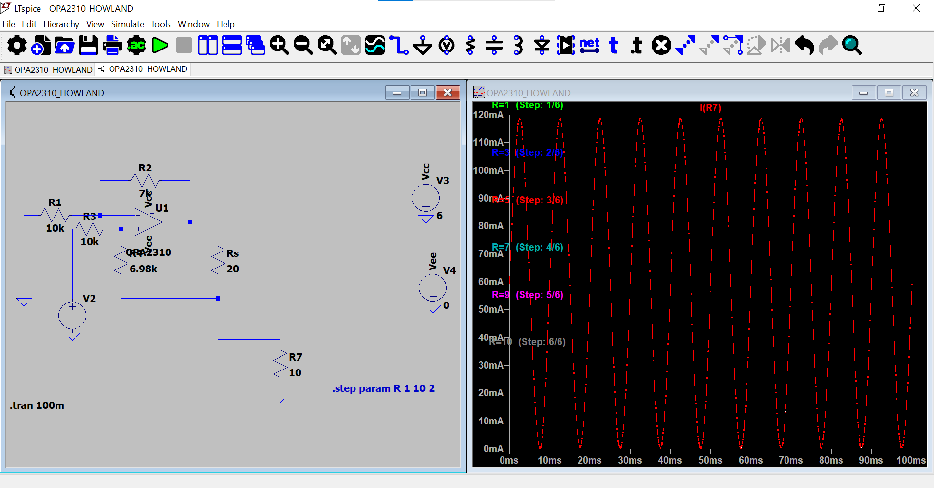
Simulation results:
Current being amplified

Slide 9
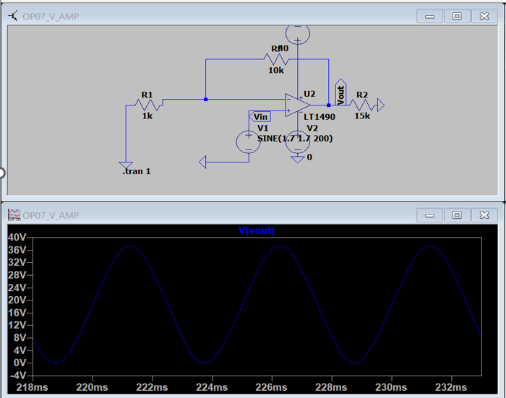
Simulation results:
Voltage being amplified

Slide 10
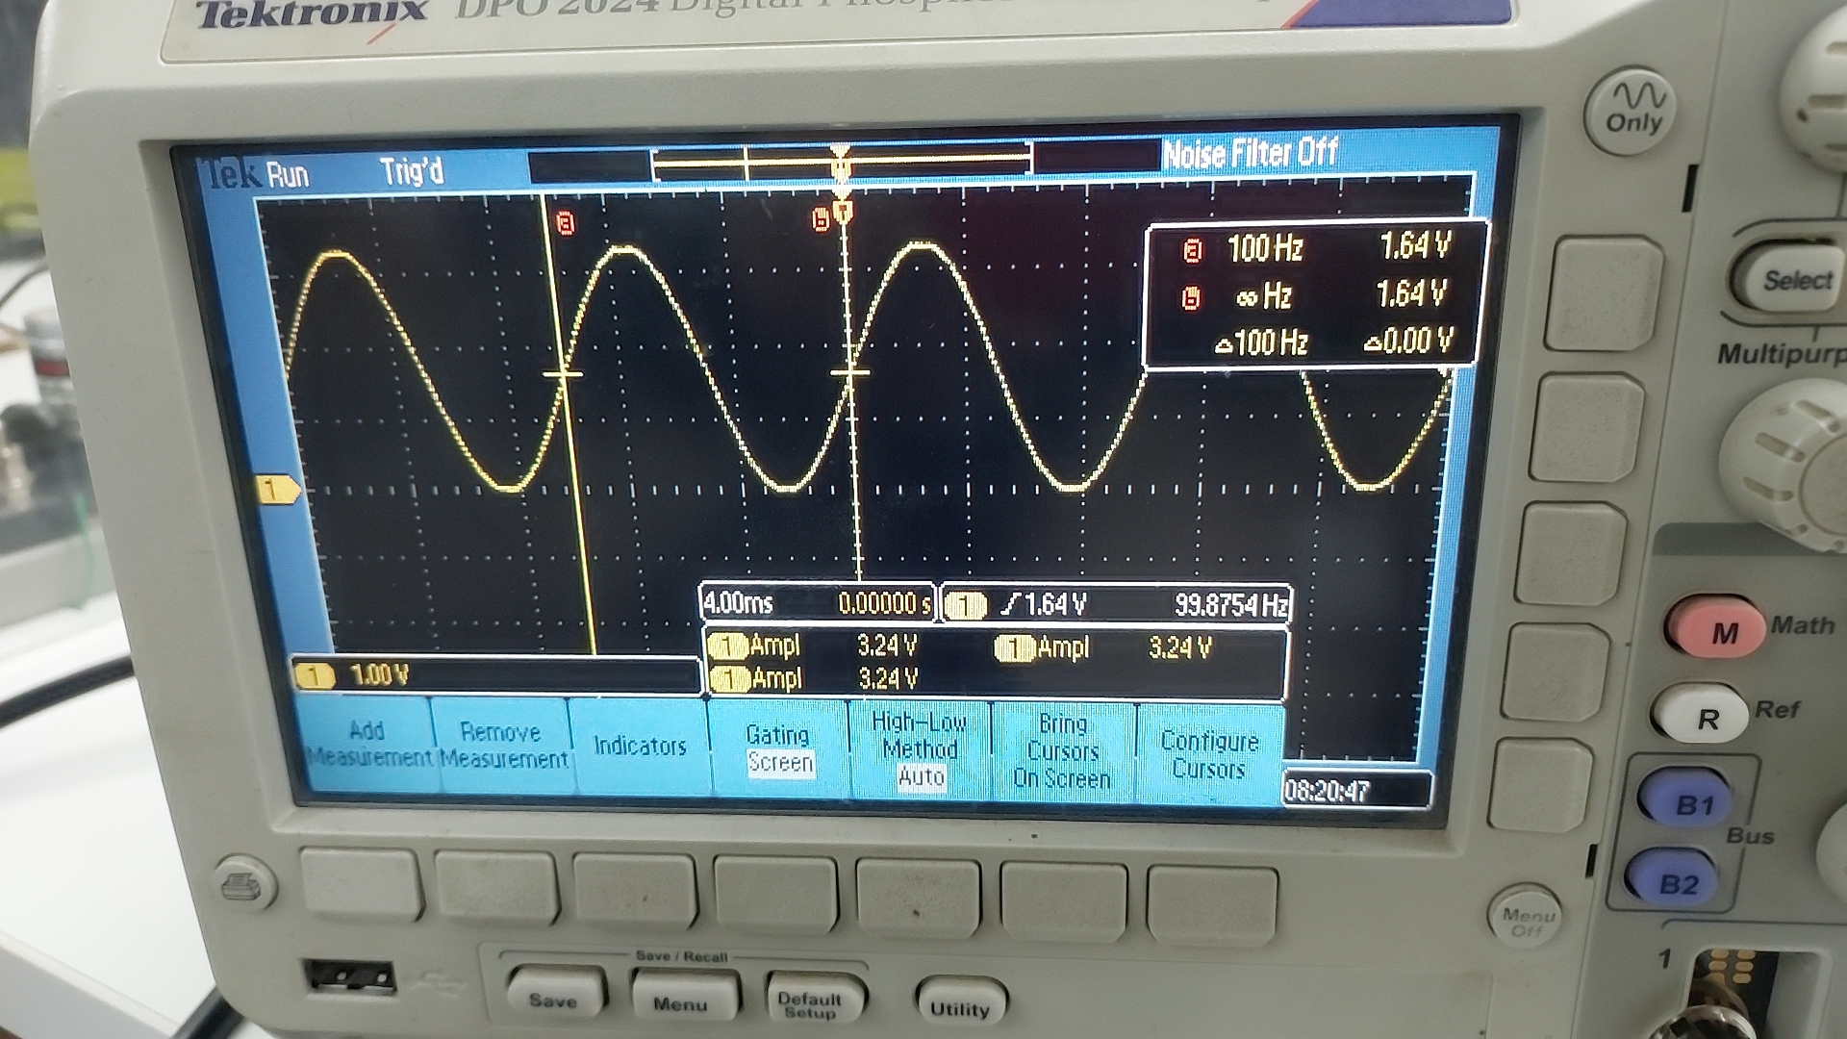
3.24V of Voltage coming from the DAC output of the STM32H7 development board

Slide 11
Future Scope: - To extract / reproduce multiple values of known V and I (For this we might not be able to fit this inside the meter, but can be developed into a small portable board) - To Find the Cal Constant - To adjust the Cal Constant within the Meter using the Controller on board.

Slide 12
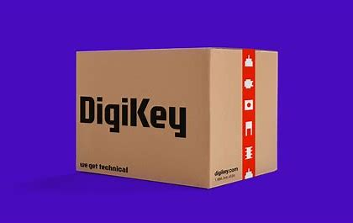
Project 2 To calculate Quotations for a excel full of component list with multiple manufacturer numbers for each component Refer the Excel sheet, DigiKey’s API, and Java script.

Slide 13
Future Scope: -To extract similar data from Mouser and element14’s API and find the best price -There might be missing components so using Mouser api also helps here.

Slide 14
THANK YOU!
-

Slide 15






Closing slide with legal line
© <<YEAR>>* Schneider Electric. All Rights Reserved. Schneider Electric and Life Is On Schneider Electric are trademarks and the property of Schneider Electric, its subsidiaries, and affiliated companies. All other trademarks are the property of their respective owners
se.com

